Slide 1
SOFTWARE IMPLEMENTATION

Slide 2

Introduction, Implementation and Code Characteristics

Slide 3
Context
Implementation phase in an SDLC starts post the Requirements, Architecture and Design, and converts the program structures developed as part of Design to actual code using some programming language.
The level of details needed before implementation can start, is dependent on whether you are using a compiled language or an interpreted language.
This will involve choice of a language, choice of a development environment, following of a configuration management plan and building code.
As part of building code, this would need the usage of Coding standards, Coding guidelines and following the language syntaxes in for translating designs to code.
Given that code can exist for a long time there are number of practices followed as part of coding to address potential concerns regarding quality, security and testability.
The entry criteria for this phase is baselined Design (Detailed design) and the exit criteria for this phase is unit tested, peer reviewed functioning code.

Slide 4
Software Construction Introduction
Definition
Software Construction or implementation is the detailed creation of working software through a combination of coding, reviews and unit testing.
Some of the fundamental goals when constructing or implementing are
Minimizing complexity
Anticipating change
Constructing for verification
Reuse
Construction for others to read
Implementation has a development environment, whether integrated or discrete, a structure which is designed for holding your code and an Software Configuration Management system driving the management of the same

Slide 5

Characterizing Software Construction
Construction produces high volume of configuration items
E.g., source files, test cases etc.
Construction is tool-intensive
relies heavily on tools such as compilers, debuggers, GUI builders etc.
Construction is related to software quality
code is the ultimate deliverable of a software project
Construction makes extensive use of computer science knowledge
in using algorithms, detailed coding practices etc.

Slide 6
Choice of a Programming Language based on levels of Abstraction
Assembly languages map directly onto the CPU architecture.
Procedural languages provide a modest level of abstraction from the underlying computer.
Aspect-orientation supported by languages are designed to allow the developer to separate aspects (or concerns) within a program.
Object-oriented languages break away from CPU architecture and further abstract the machine by enabling the designer and the developer to consider the problem in terms of objects.

Slide 7
Development Environment - 1
Choice in selecting development & implementation environments
restricted by the choice of language, methodology, application, and development and target hardware platforms
Some factors in selecting development environments:
Commercial vs. open-source
Developers often prefer open-source tools, but some organizations think that open-source tools are untrustworthy or less capable than commercial tools
Support of development process
Support of the development process includes ensuring that tools such as debuggers, test builders, and analysis tools are available

Slide 8
Development Environment (DE) - II
Some factors to be considered in selecting DEs:
Security
Framework, language & tools may affect vulnerability to external attack
Access to future capabilities
Future capabilities of tools should be considered when choosing tools
Size of product and distribution of development team
Large projects are more complex and may require a larger Dev Env
Degree of integration among /between tools and environment
This enhances productivity by enabling or easing activities such as tracing requirements to code segments, generating skeleton code from models, or debugging

Slide 9
Coding
Coding activity begins once the Development environment is chosen.
Prominent Quotes of Kernighan
"Where there are two bugs, there is likely to be a third.“
“Don't patch bad code - rewrite it."
"Don't stop with your first draft."

Slide 10
Coding : Journey of a Bug
Coding activity begins once the Development environment is chosen.
Journey of a bug Starts here
Consider the following piece of (buggy) code:
if (x < 99)
process_event();
else ???
Not specified 🡺 System can misbehave
Bug Travels !!
Our above code could be used in a touch panel driver
Industrial, automotive, aeronautics …
What does our bug do?
It makes the right edge to go undetected
Most Likely
x <= 99
X = 99

Slide 11
Where can we catch the Bug
Coding – before the bug occurs!
Code review
Unit testing
Integration testing
System testing
Field trials
Production

Slide 12
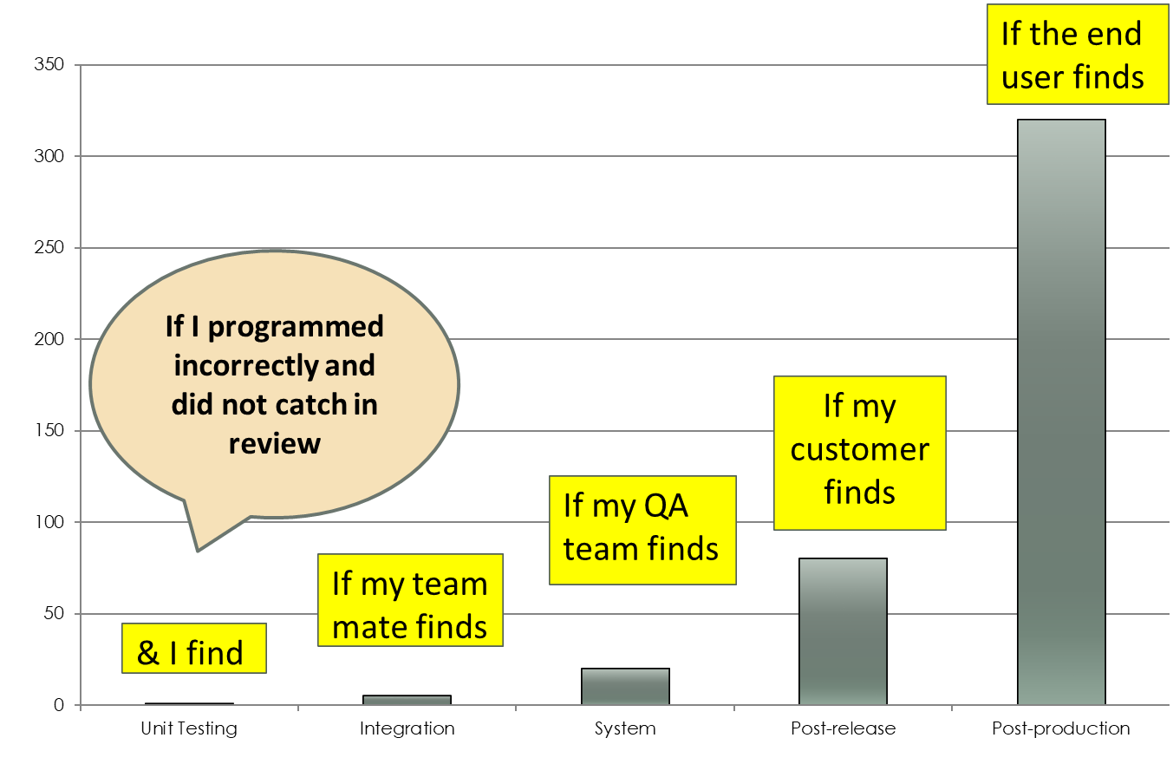
How expensive is the Bug

Slide 13

Keep these thoughts in mind while programming
A program is for the programmer who reads it, not for the computer that runs it.
A program is written once, but read and modified a lot many times.
Assume that the person who will end up maintaining your code is a psychopath who knows where you live
Minimize the complexity of code which you write
When reviewing code, count to 5 before concluding, 10 before refactoring

Slide 14
Program Personalities
Programs have "personalities": messy, verbose, cryptic, neat. What is yours?!
Programs can also give an indication of the personalities of individuals
The Under documenter
The CYA specialist (Cover your ..)
The CIO types .. Who will pass the buck to other modules
The dynamic types .. Create variables on the fly ..
The fakers … look for more repetitious activities like Build management
The Multitasker .. Who leverages and uses some wrappers and glue rather than rewriting
The True believer .. Who will write extensive documentation
…….

Slide 15
Characteristics of Code
Some of the different characteristics of code are
Programs should be Simple and Clear
Naming
Structuring
File Structure
Code and Data Structure
Ease of reading and Understanding
Whitespaces
New Lines
Indents
Commenting
Well named, structured, easy to understand code is easy to verify, debug, test, maintain and reuse

Slide 16
Code Characteristics : Programs should be Simple and Clear
Programs should be well thought out, well designed, well structured although Programmer’s have a tendency to jump start
"Not too many"
Lines per function
Lines or functions per file
Arguments per function
Levels of nesting
Conditions

Slide 17
Code Characteristics : Naming & Naming Conventions
Naming is important! and have to be Meaningful and should not be close to keywords
Its good to have descriptive names. Although it might be ok to use short names for local variables, its good to use 2-3 character short names
Naming could be done as
Pascal Casing (first letter upper case other lower case) e.g. BackColor for class names/Variable Names/ method parameters
Camel Casing (first letter upper case others lower case except 1st word) e.g. backColor for method names
Underscore Prefix (_underScore) For underscore ( __ ), the word after _ use camelCase terminology
What is in a name? A rose by any other name would smell as sweet.
- William Shakespeare
… BUT

Slide 18
Code Characteristics : Naming convention – Examples
What does the following code do?
int uglyduck (int timer_count)
{
if (timer_count <= 1)
return 1;
else
return timer_count * uglyduck(timer_count-1);
}
---------------------------------------------------------
for (i = 0; i < nelems; i++)
sum += elems[i];
for (iElementIndex = 0;
iElementIndex < iNumOfElements;
iElementIndex++)
{
sumOfElements += ElementArray[iElementIndex];
}
Need meaningful Names
With Descriptive Names

Slide 19
Code Characteristics : Other Naming conventions
There are other naming conventions to maximize code portability across compilers like
No variable shall have a name that is a keywords of programming languages
No variable shall have a name that starts with an underscore
No variable name shall be longer than 31 characters
No variable name shall contain any numeric value that is called out elsewhere
Each variable name shall be descriptive of its purpose
…….

Slide 20
Code Characteristics : Structuring
Structure refers to the dependencies between software components (subprograms, parameters, code blocks, etc). Dependencies can be highlighted through proper naming and layout. For example, dependent subprogram interface/implementation declarations should be closer to each other.
File structure
Logically grouped
#includes, #defines, structures, functions
Well partitioned
What goes into a header file? What goes into a C file?
What functions/variables should be exposed?
Code and data structure
Everything that you learnt in ADT!
Well encapsulated, logically grouped.
Properly initialized!

Slide 21
Code Characteristics : Ease of Reading and Understanding
Readability is dependent upon identifier naming and the visual layout of statements. For example, use standardized indentation and blank lines/spaces to illustrate blocks of code and their hierarchical dependencies.
Addition of Spaces
E.g. for(int i=0;i<40;i++)
for( int i = 0; i < 40; i++)
How is this compared to
The earlier one
How is this compared to

Slide 22
Code Characteristics : Ease of Reading and Understanding
Addition of new lines
for (i = 0; i < len; i++) if (num == array[i]) break;
if (i == len) return -1; else return i;
for (i = 0; i < len; i++)
if (num == array[i])
break;
if (i == len)
return -1;
else
return i;
Use of Parenthesis
E.g. if (c >= ‘0’ && c <= ‘9’ || c >= ‘a’ && c <= ‘f’ || c >= ‘A’ && c <= ‘F’)
Soln -

Slide 23
Code Characteristics : Ease of Reading and Understanding
Comments for code should explain and clarify the program, rather then simply repeat code. Comments should concisely and clearly explain the underlying logic. They should not be cryptic or misleading, and must be easy to identify using proper indentation, spacing and ‘highlighting’ (e.g., comment boxes).
Well Commented.
/* Enable interrupts, start Rx and Tx. */
CFGREG = 0x1003;
vis-a-vis
/* Check if the pointer is NULL. */
if (alloc_ptr == NULL)
panic ();
Which is very obvious and redundant

Slide 24
Do’s of good programming style
Use a few standards, agreed upon control constructs.
Use GOTO in a disciplined way.
Use user-defined data types to model entities in the problem domain.
Hide data structure behind access functions
Use appropriate variable names
Use indentation, parentheses, blank spaces, and blank lines to enhance readability.

Slide 25
Don’ts of good programming style
Don’t be too clever.
Avoid null Then statement
Avoid Then If statement
Don’t nest too deeply.
Don’t use an identifier for multiple purposes.
Examine routines having more than five formal parameters.

Slide 27
Refactoring Code
Refactoring consists of improving the internal structure of an existing program’s source code, while preserving its external behavior.
Refactoring is intended to improve the
Design, structure, and/or implementation of the software (its non-functional attributes), while preserving its functionality.
Refactoring improves objective attributes of code (length, duplication, coupling and cohesion, cyclomatic complexity) that correlate with ease of maintenance
refactoring helps code understanding
Refactoring does “not” mean:
rewriting code
fixing bugs
improving observable aspects of software such as its interface

